Slide 1


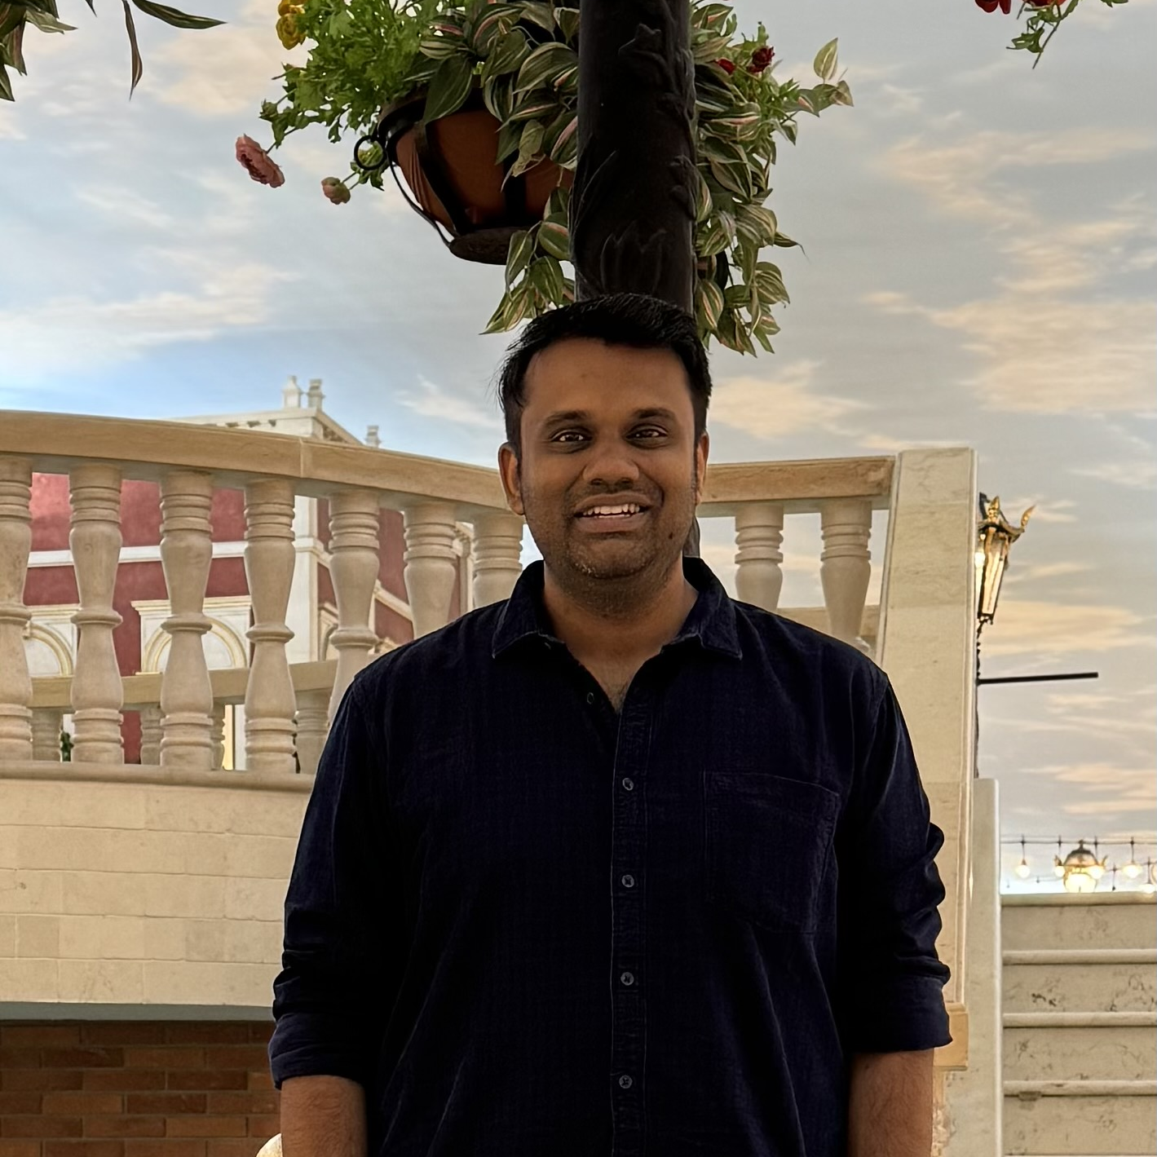
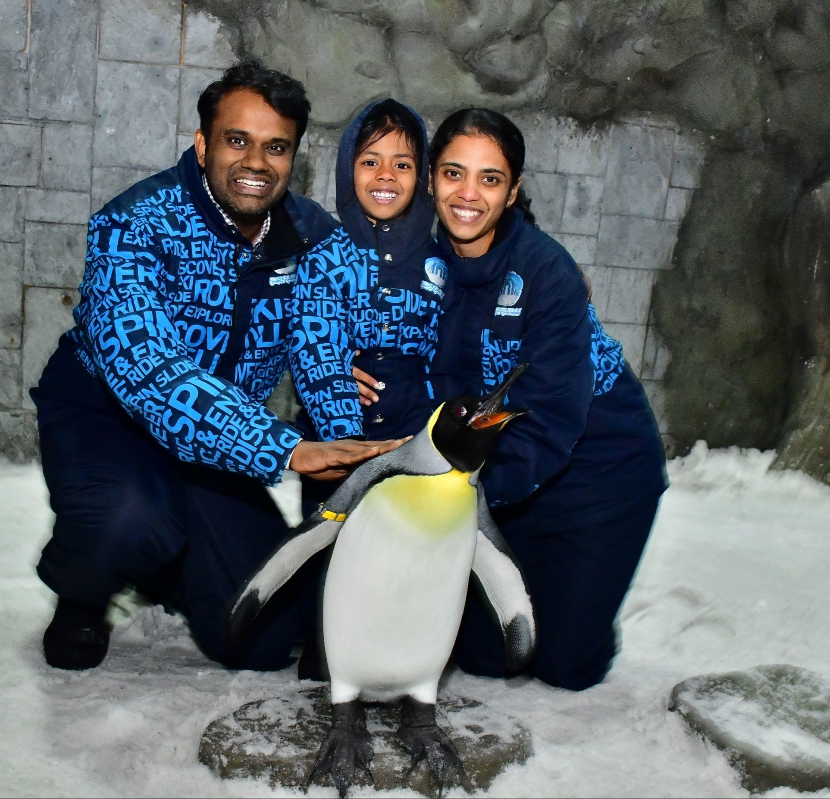

Getting to Know Me
Work
Personal
My role
General Manager – Cocoa and Cashew, Nigeria
Significant others / family members / furry friends in my life
My wife – Nandhini, My Daughter – Miraya, My Mom - Sulochana
Tenure in ofi/Olam
8 Years
How I enjoy spending my free time
Time with family, Fitness ,Stock market .
Previous companies I have worked at
Urban Ladder ,Infosys
My favorite / comfort food
Chicken
Why I joined ofi/Olam and what keeps me here?
The potential for growth within the company and the meaningful work I do here have always been truly motivating.
My favorite song
Mundhinam parthaenae
Arunkarthick Ashokkumar
Space Science enthusiast – always dreaming about the unknown galaxies. love diving into the unknown.
This is me outside work, doing stuff I enjoy in my life …

